Slide 1


Detecting Fraud in Vehicle Insurance Claims
MARYAM JAFFAR ALQASSAS
DAB 16

Slide 2

Agenda
INTRODUCTION
PROBLEM STATEMENT
OBJECTIVES
ANALYSIS
RECOMENDATIONS
CONCLUSION

Slide 3


introduction
Car insurance fraud is a growing issue that increases costs for insurers and honest customers. This project analyzes vehicle insurance data to identify patterns linked to fraudulent claims and later on, help insurance companies strengthen fraud detection and reduce its impact on the industry.

Slide 4



about
Sureway insurance
SureWay Insurance, founded in the early 1990s, is a trusted insurance provider known for reliable service and customer-focused solutions. Over the years, the company has expanded its offerings to include vehicle insurance along with home insurance. With a strong reputation for fairness and fast claim handling, SureWay combines decades of experience with modern digital tools to deliver simple, secure, and transparent insurance services.

Slide 5

problem statement
SureWay Insurance has experienced an increase in suspicious claims by 6% from 1993 until 1996, which increased its operating costs and afftected customer confidence.

Slide 6



Objectives
Do fraud cases increase in certain months?
Is fraud more common in urban or rural areas?
Which vehicle makes have the highest fraud rates?
Does gender affect the likelihood of fraud?
How does marital status relate to fraud?
Which policy type (Liability, Collision, All Risks) has the highest fraud rate?
Are certain vehicle categories (Sedan, Sport, Utility) linked to higher deductibles in fraud cases?
Does the day of the week impact fraudulent claim filings?
How does the age group relate to fraud probability?

Slide 7




Analysis

Slide 8
General Information

Slide 9
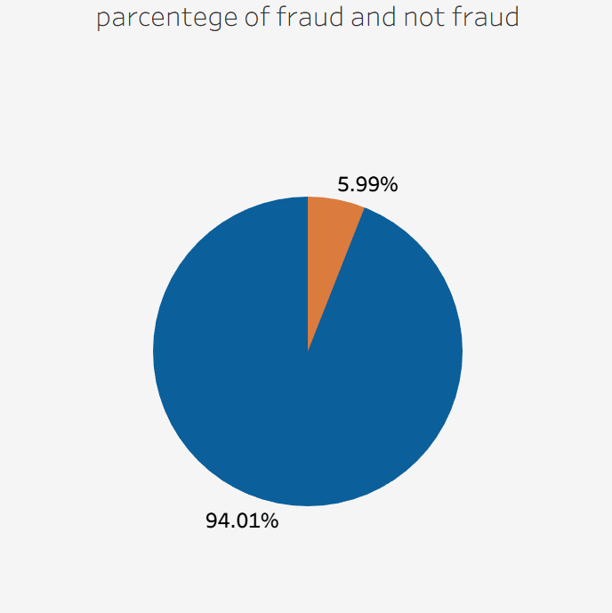
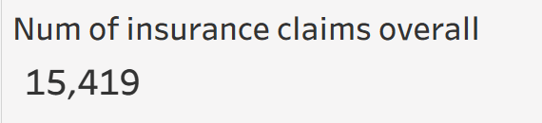

Slide 10

Time Analysis

Slide 11
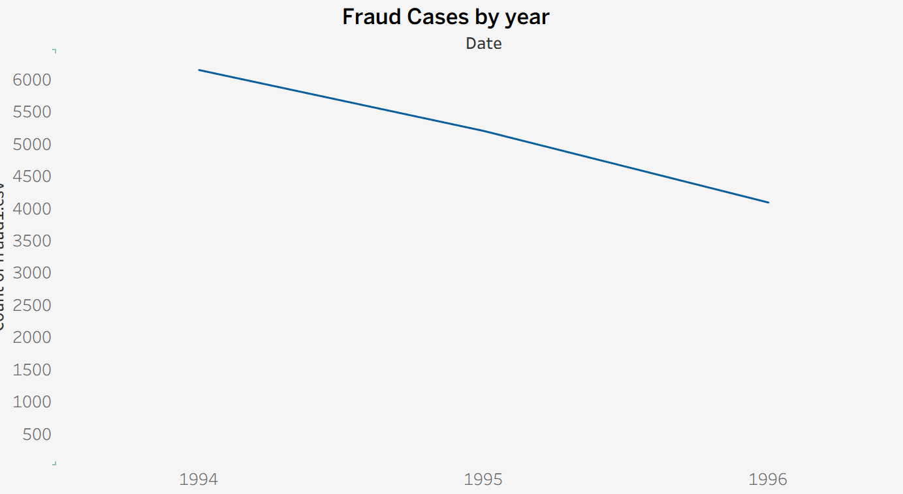

Slide 12
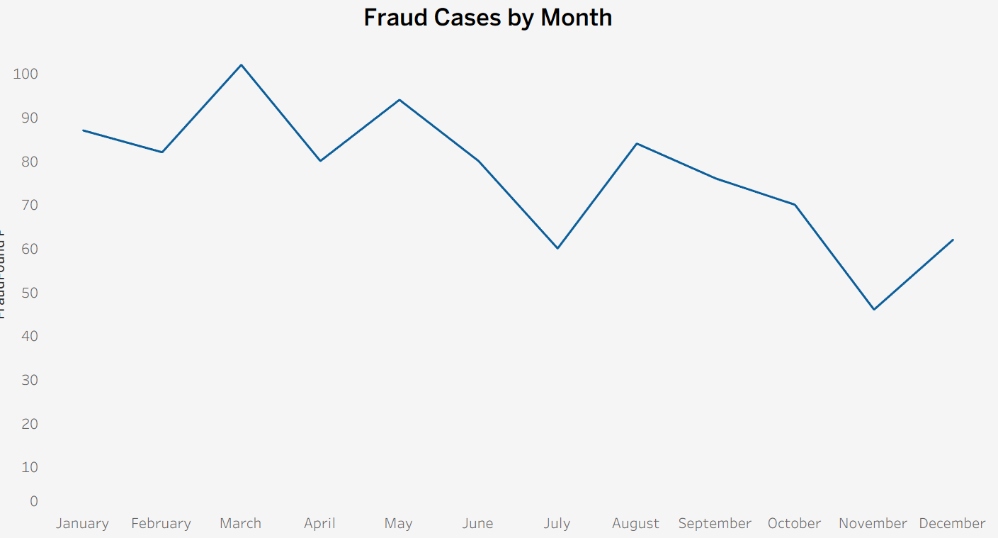

Slide 13
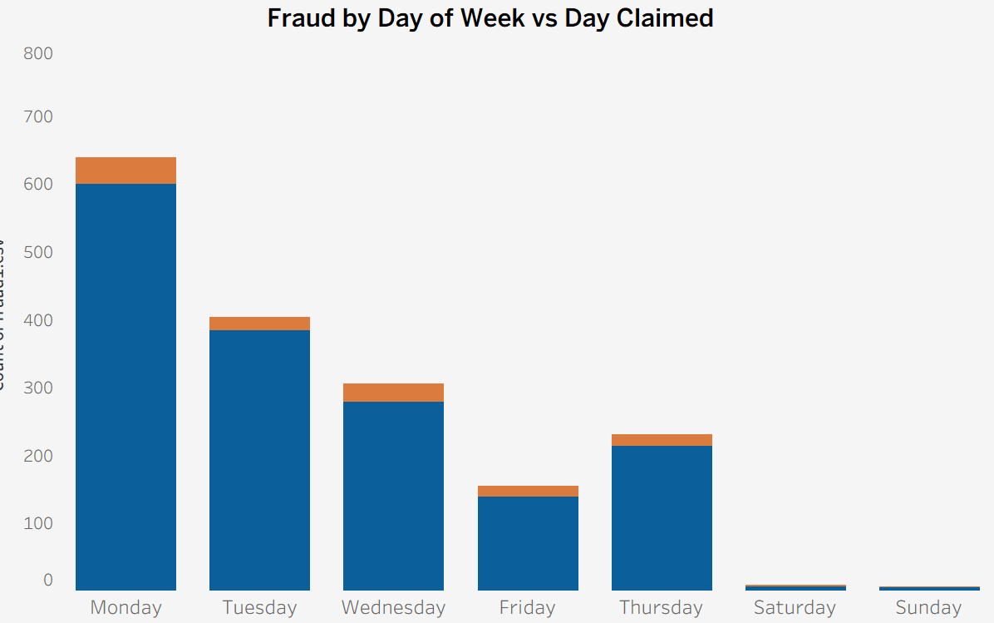

Slide 14

Recommendation
Increased monitoring during high-risk periods
Improving strategies that have historically reduced fraud

Slide 15
Vehicle Analysis

Slide 16
Type of policy
Liability: Covers damages to others caused by you only.
Collision: Covers damage to your vehicle in a collision.
All perils: Covers most potential damages and losses.

Slide 17
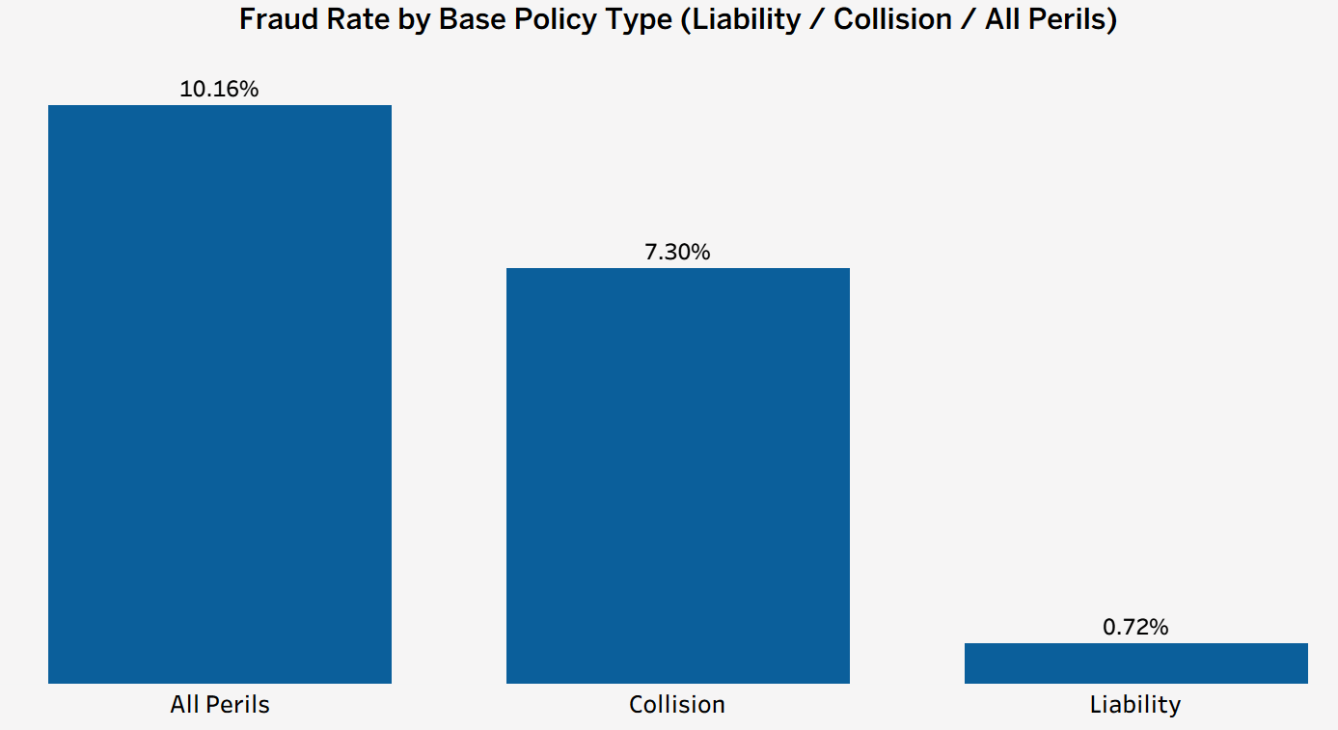

Slide 18



Type of cars
Sedan car
Utility car
Sport car

Slide 19
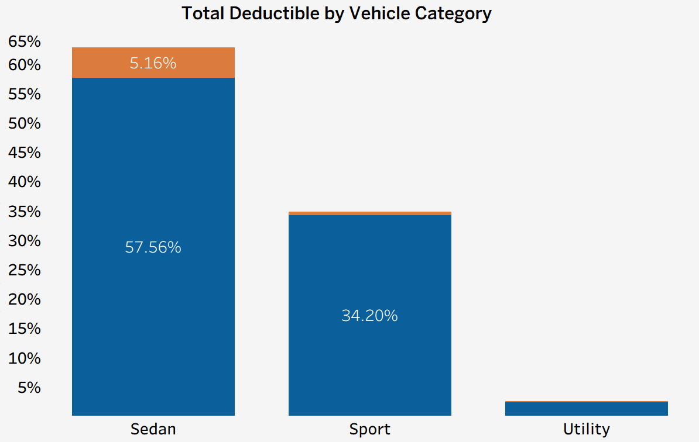

Slide 20
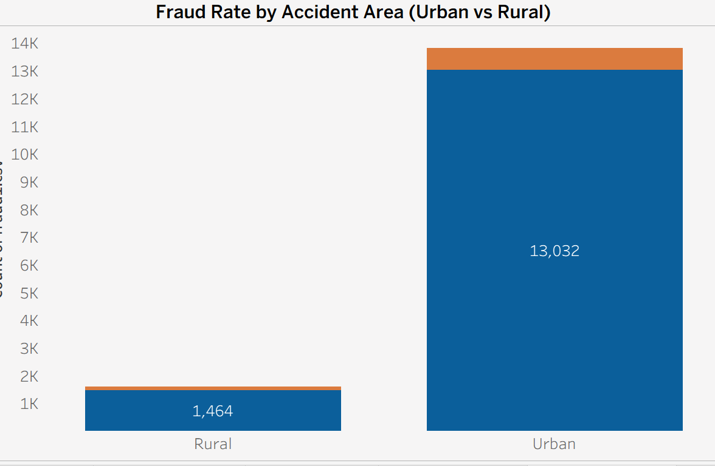

Slide 21
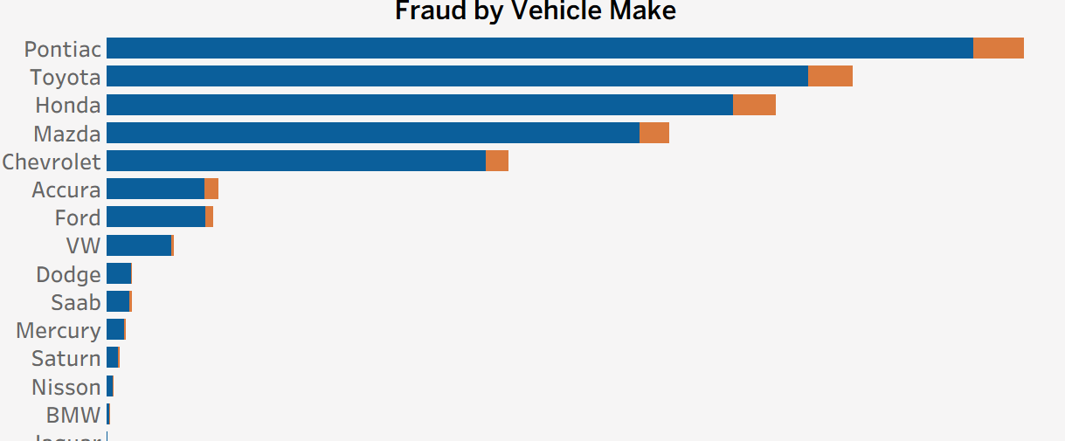

Slide 22
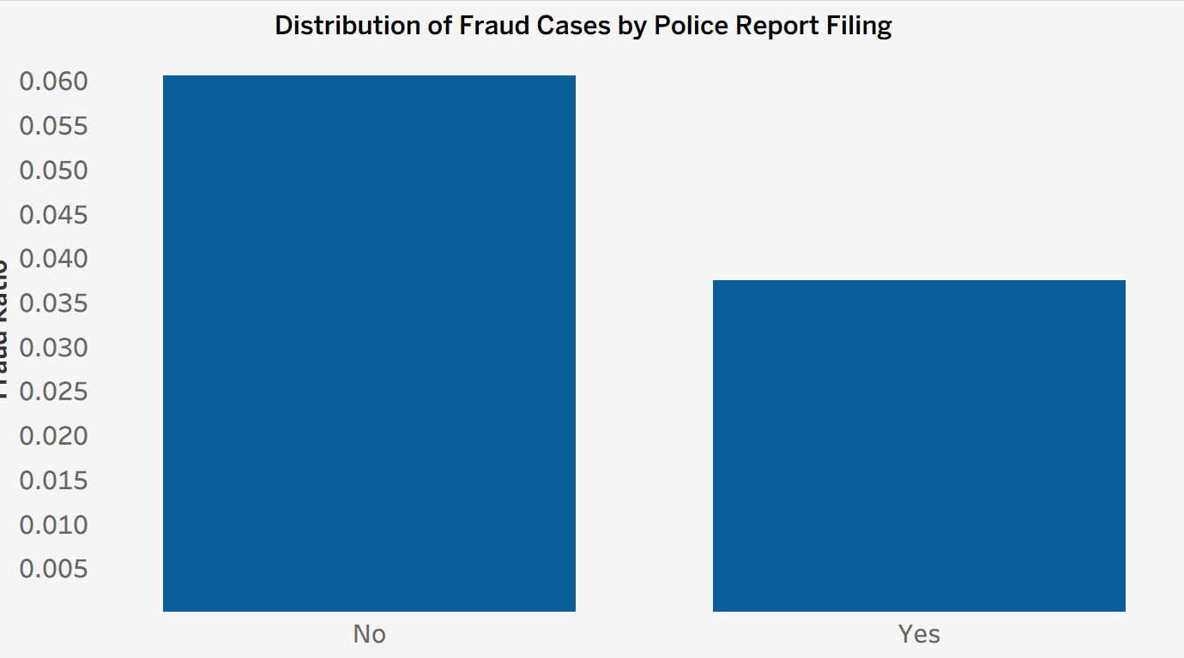

Slide 23
Recommendation
Improving pricing and coding policies by vehicle type can help with a more accurate allocation of risk and reduce the likelihood of fraudulent claims.
Monitoring fraud patterns associated with specific vehicle makes can guide insurers to strengthen their due diligence procedures before issuing or renewing policies

Slide 24
Owner Analysis

Slide 25
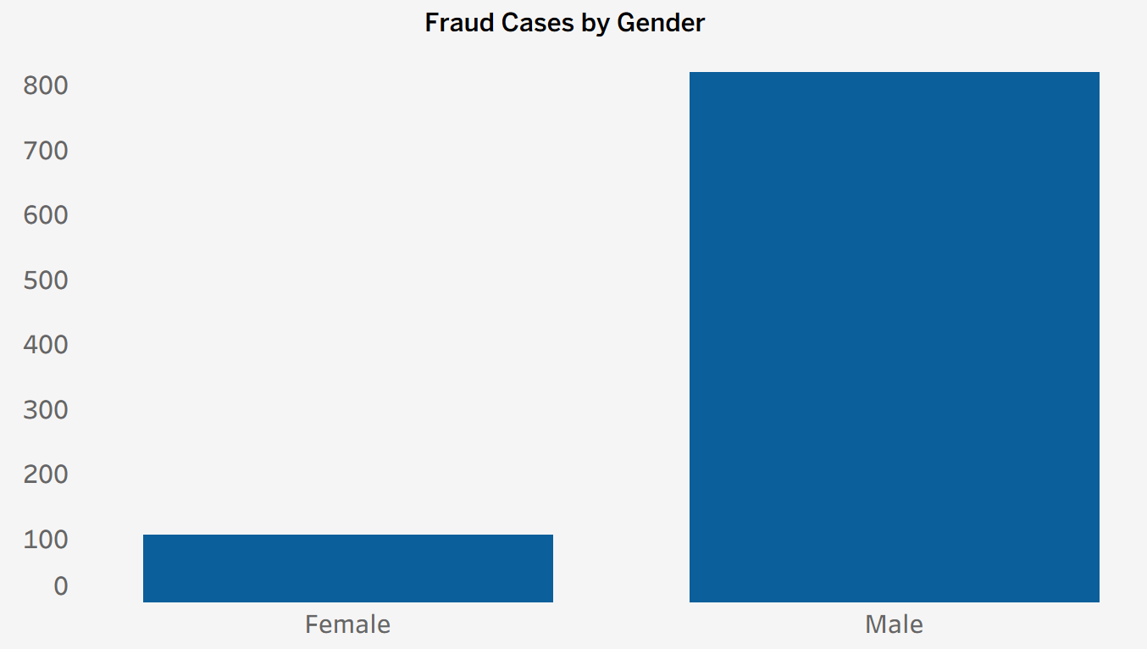

Slide 26
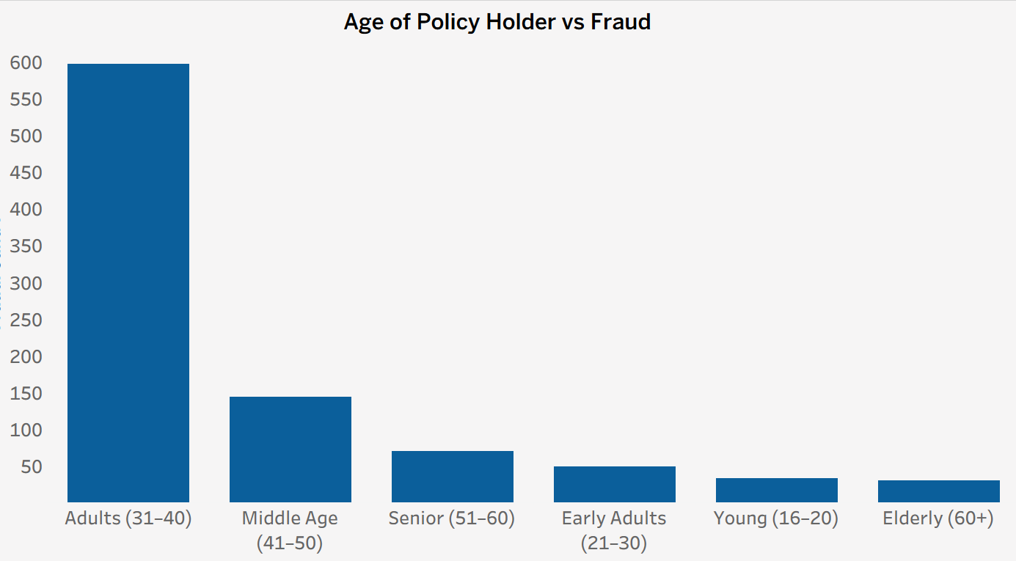

Slide 27
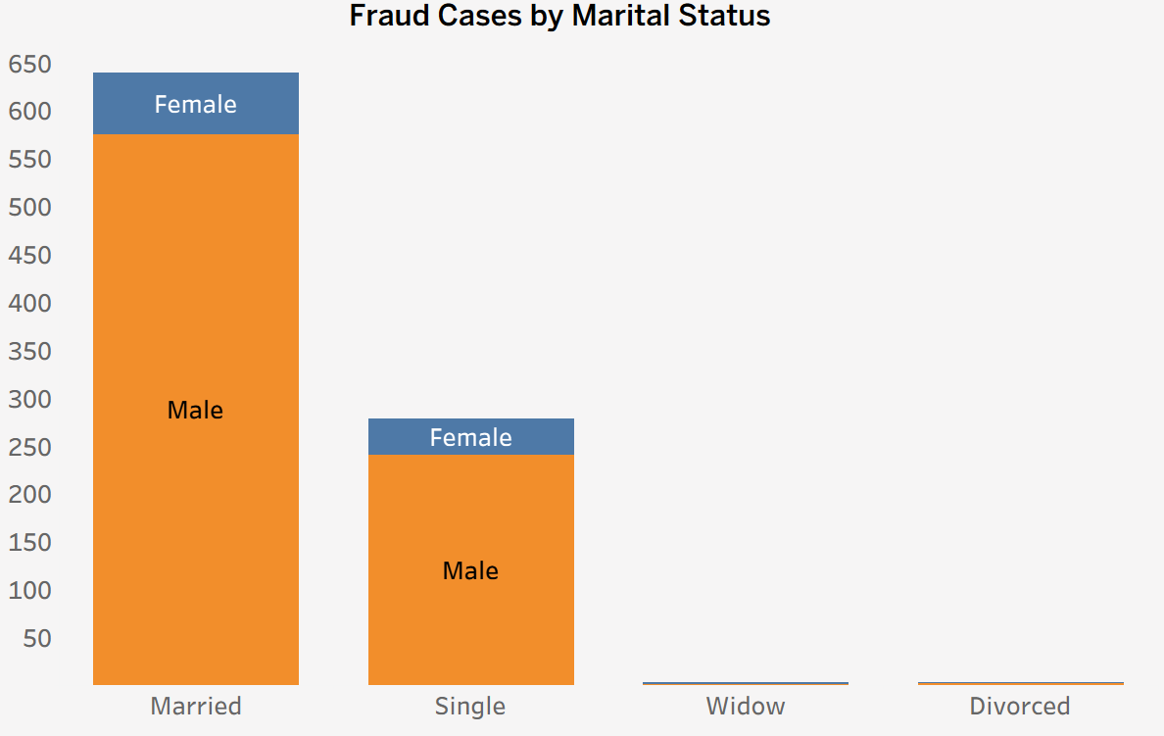

Slide 28
Recommendation
Strengthening scrutiny of high-risk fraud groups, such as men and adults aged 31–40, helps direct resources toward high-risk claimants.
Reviewing fraud patterns by marital status and gender can support the development of more precise targeting policies that reduce fraudulent claims in the future.

Slide 29

conclusion
By strengthening oversight during high-risk periods, improving pricing and verification policies related to vehicle type, and focusing on the most fraud-prone categories among policyholders, insurance companies can build a more accurate system for detecting and reducing fraud, thereby increasing operational efficiency and reducing future losses.

Slide 30

THANK YOU FOR LISINING

